Slide 1
THRIFTING BUSINESS

Slide 2



Samples of clothes in Benjamin’s business

Slide 3
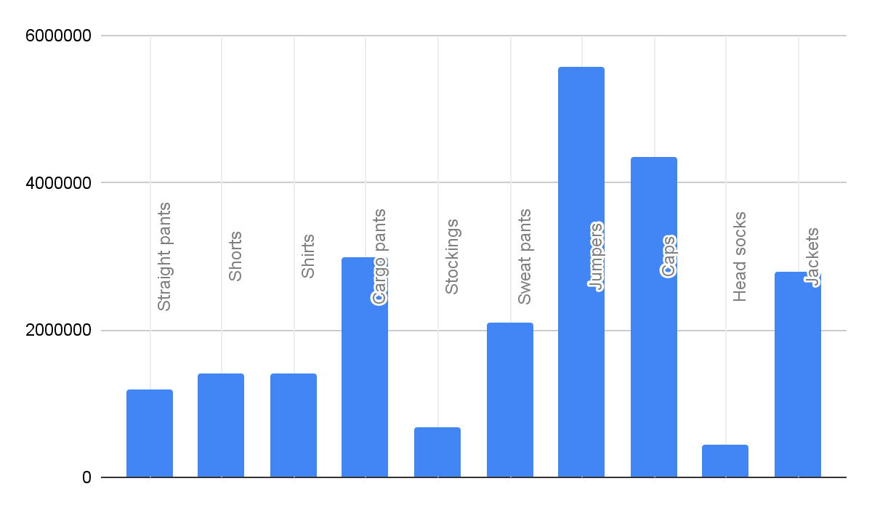
A bar graph showing total cost of Benjamin’s business

Slide 4
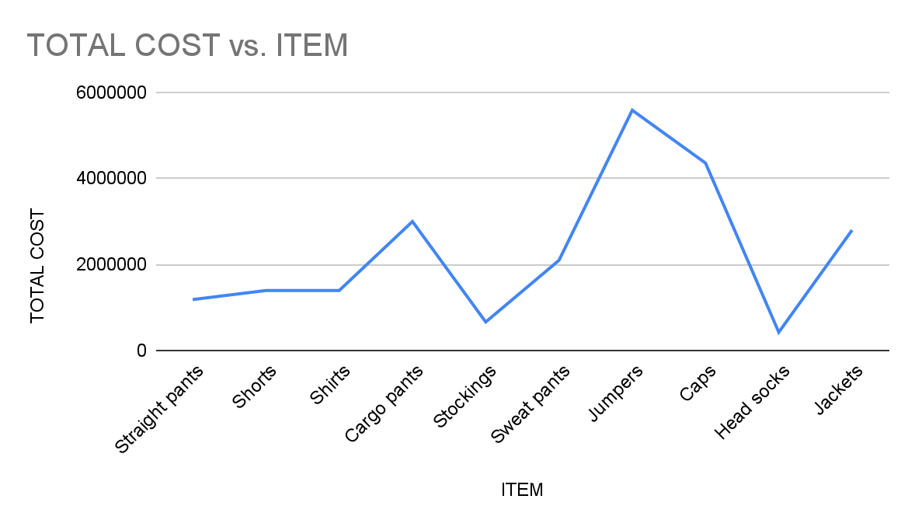
A line graph showing Benji’s thrifting business

